Slide 1


DATA COMMUNICATION
CSE 225/233
WEEK-5, LESSON-1
ANALOG TRANSMISSION

Slide 2
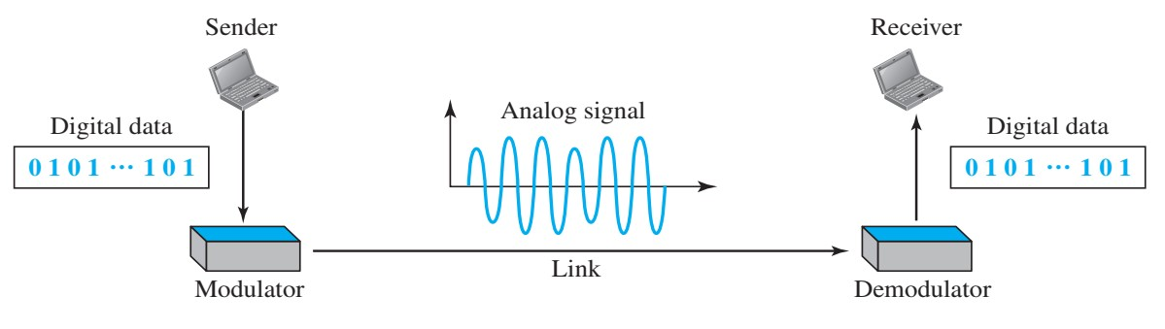
Digital to Analog Conversion
Digital-to-analog conversion is the process of changing one of the characteristics of an analog signal based on the information in digital data.
Topics discussed in this lesson: Aspects of Digital-to-Analog Conversion Amplitude Shift Keying
Frequency Shift Keying Phase Shift Keying
Quadrature Amplitude Modulation

Slide 3
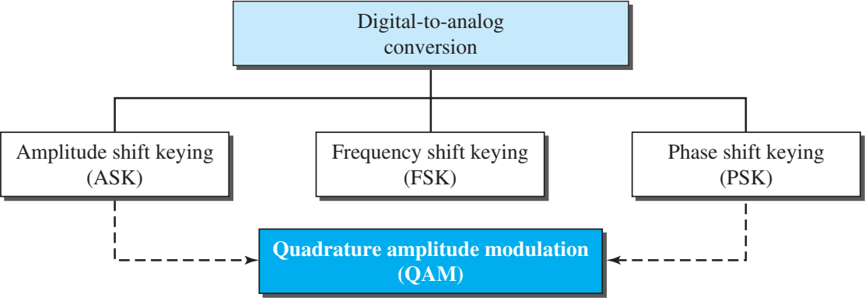
Types of digital-to-analog conversion

Slide 4

Aspects of digital-to-analog conversion
Bit rate is the number of bits per second. Baud rate is the number of signal elements per second.
In the analog transmission of digital data, the baud rate is less than or equal to the bit rate.
The relationship between bit rate and baud rate is:
where N is the data rate (bps) and r is the number of data elements carried in one signal element.

Slide 5
Example (1)
An analog signal carries 4 bits per signal element. If 1000 signal elements are sent per second, find the bit rate.
Solution
In this case, r = 4, S = 1000, and N is unknown. We can find the value of N from

Slide 6
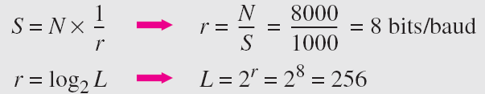
Example (2)
An analog signal has a bit rate of 8000 bps and a baud rate of 1000 baud. How many data elements are carried by each signal element? How many signal elements do we need?
Solution
In this example, S = 1000, N = 8000, and r and L are unknown. We find first the value of r and then the value of L.

Slide 7
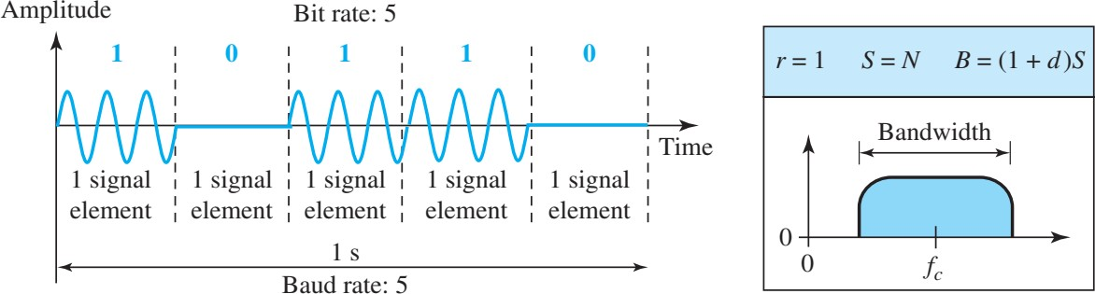
Amplitude Shift Keying (ASK)
In ASK the amplitude of the carrier is varied to represent binary 1 or 0. Frequency and phase remain constant.
ASK is highly susceptible (liable) to noise interference
Minimum bandwidth required for transmission is equal to the baud rate. BW = (1+d) S_{baud}, where d=modulation factor

Slide 8
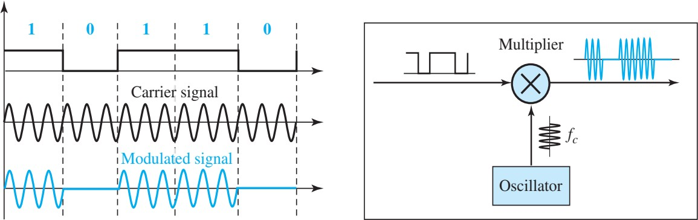
Implementation of ASK (BASK)

Slide 9
Example (1)
We have an available bandwidth of 100 kHz which spans from 200 to 300 kHz. What are the carrier frequency and the bit rate if we modulated our data by using ASK with d = 1?
Solution
The middle of the bandwidth is located at 250 kHz. This means that our carrier frequency can be at f_{c} = 250 kHz. We can use the formula for bandwidth to find the bit rate (with d = 1 and r = 1).

Slide 10
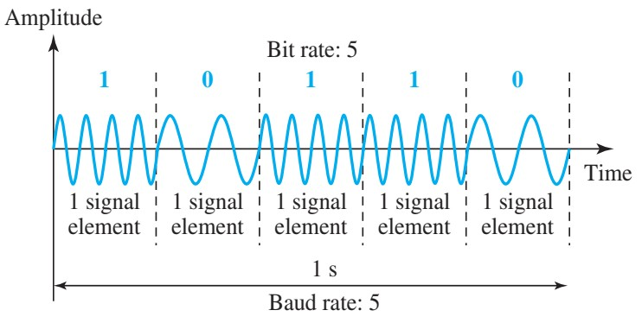
Frequency Shift Keying (ASK)
In frequency shift keying, the frequency of the carrier signal is varied to represent data. The frequency of the modulated signal is constant for the duration of one signal element, but changes for the next signal element if the data element changes. Both peak amplitude and phase remain constant for all signal elements.

Slide 11
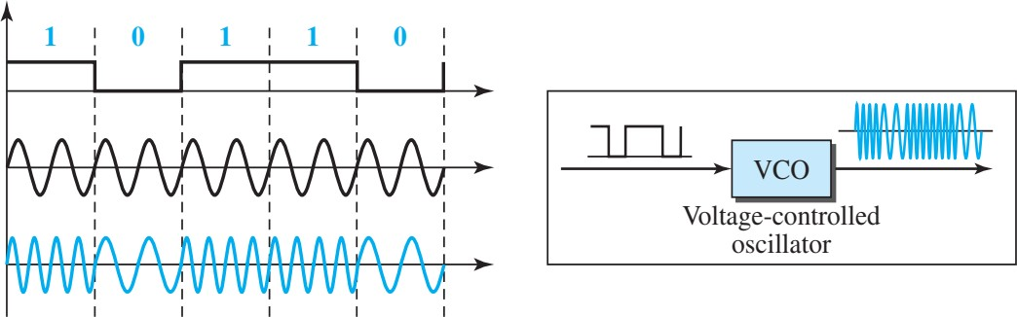
Implementation of FSK (BFSK)

Slide 12
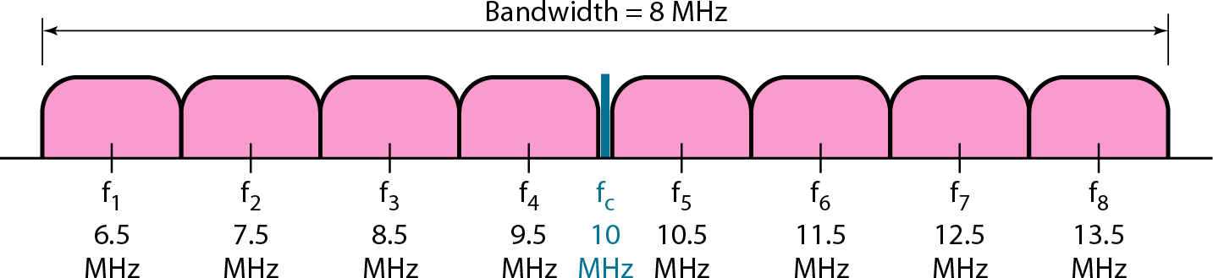
Example (1)
We need to send data 3 bits at a time at a bit rate of 3 Mbps. The carrier frequency is 10 MHz. Calculate the number of levels (different frequencies), the baud rate, and the bandwidth.
Solution
We can have L = 23 = 8. The baud rate is S = 3 MHz/3 = 1000 Mbaud. This means that the carrier frequencies must be 1 MHz apart (2Δf = 1 MHz). The bandwidth is B = 8 × 1000 = 8000.

Slide 13
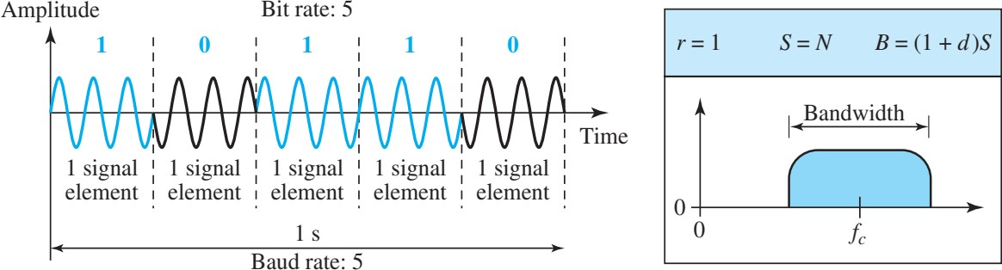
Phase Shift Keying (PSK)
In PSK the phase of the carrier is varied to represent binary 1 or 0. Peak amplitude and frequency remain constant.
This method is often called 2-PSK or binary PSK
The minimum bandwidth required for PSK transmission is the same as that for ASK: BW = (1+d) Sbaud, where d=modulation factor.

Slide 14
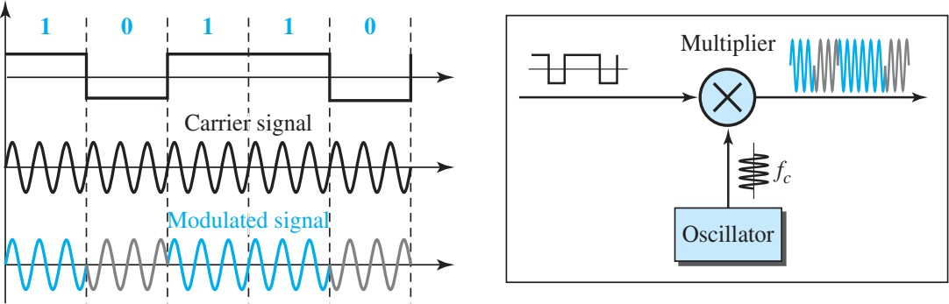
Implementation of PSK (BPSK)

Slide 15
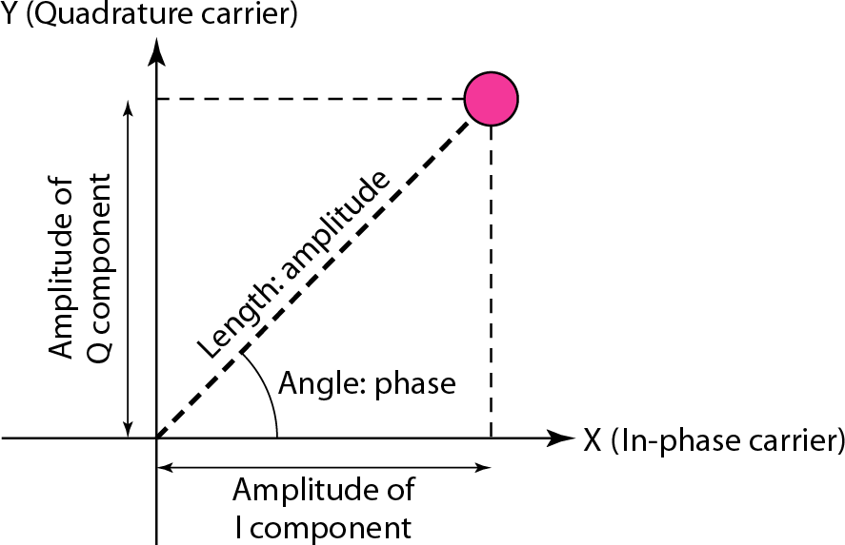
Concept of Constellation Diagram
5.15

Slide 16
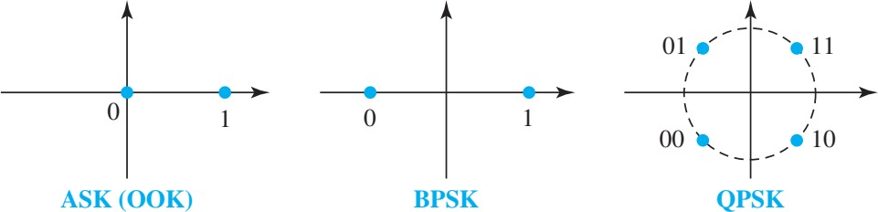
Example (1)
Show the constellation diagrams for an ASK (OOK), BPSK, and QPSK signals.
Solution
5.16

Slide 17
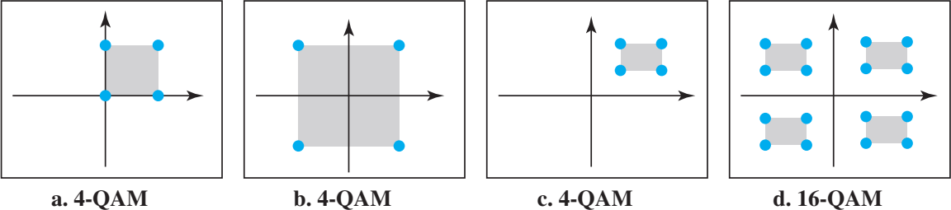
Example (2)
Quadrature amplitude modulation is a combination of ASK and PSK.
Few Constellation Diagram
5.17

Slide 18


